Slide 1
Polymorhısm

Slide 2
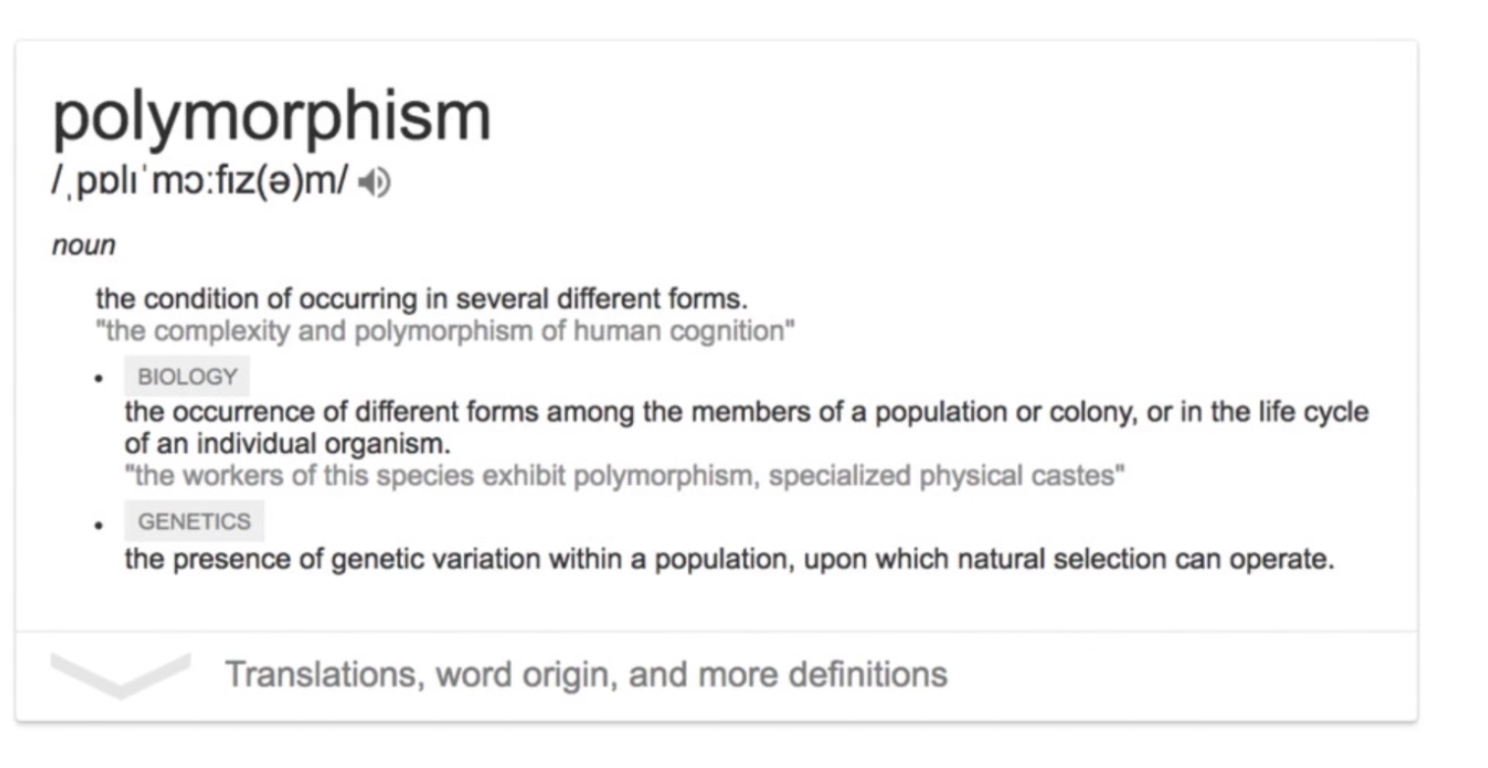
Polymorhism

Slide 3



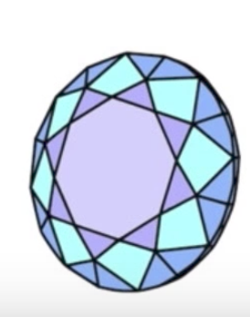


Slide 4
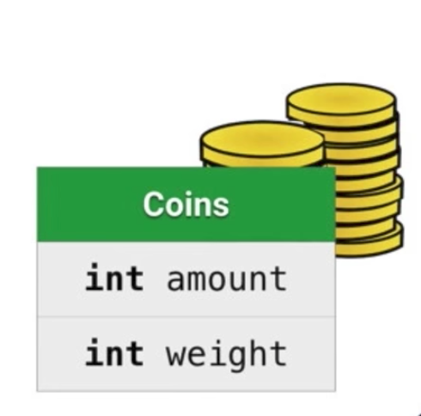
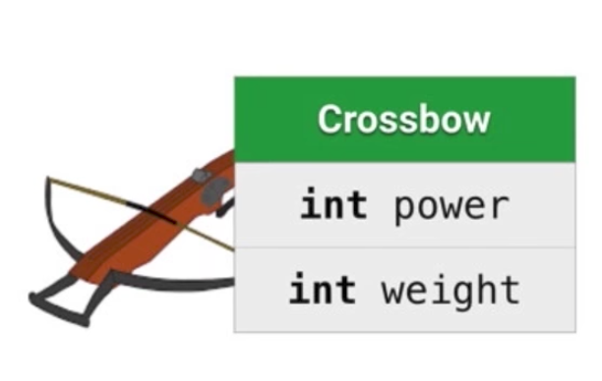
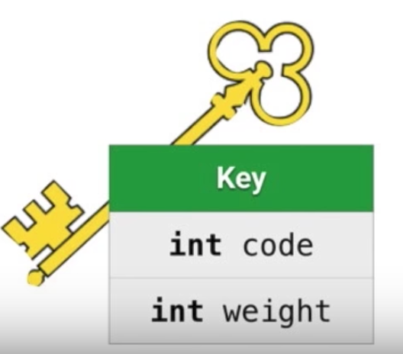
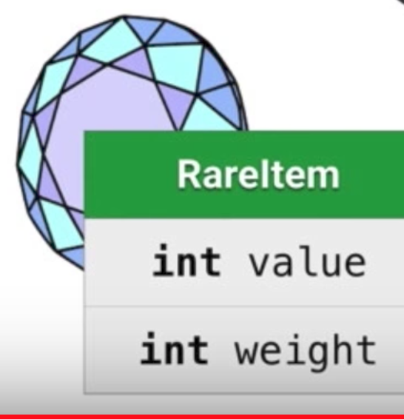

Slide 5
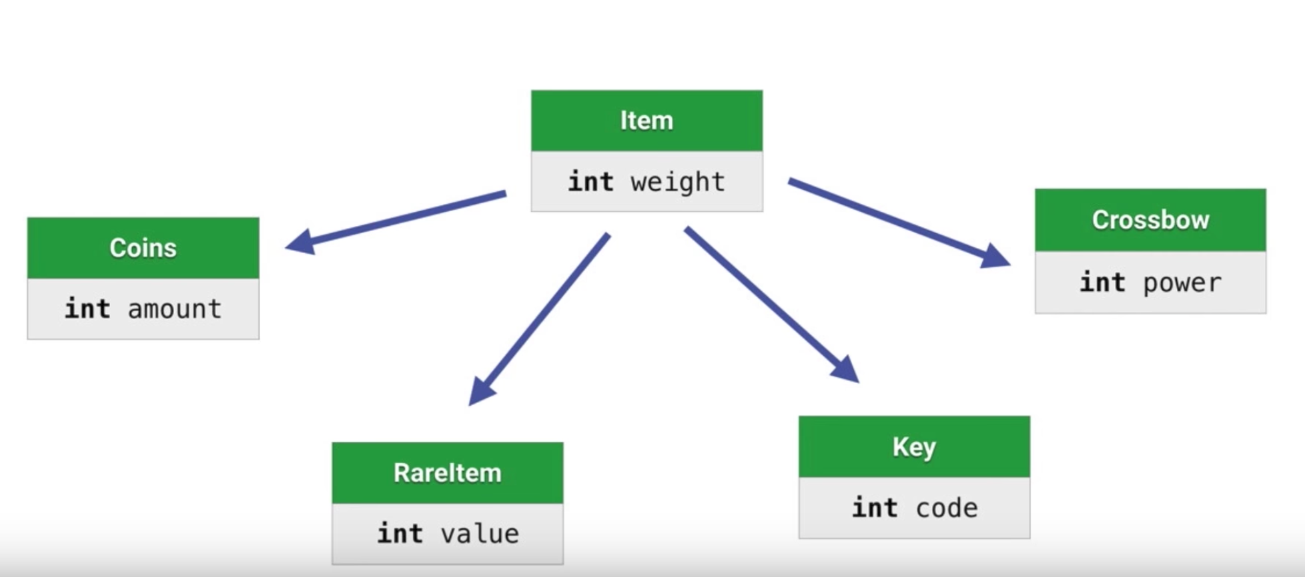

Slide 6
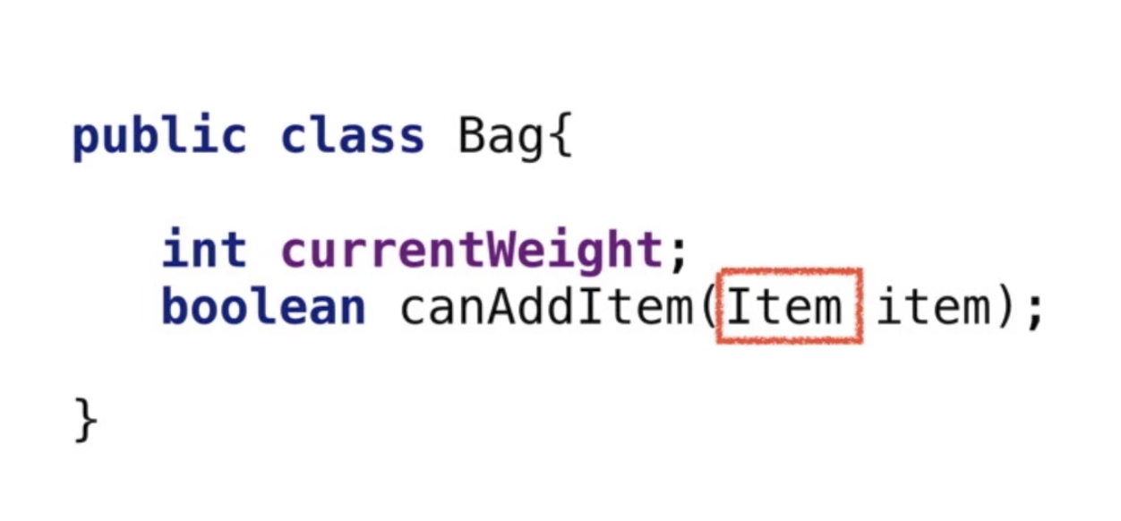
Bag & Items Example

Slide 7
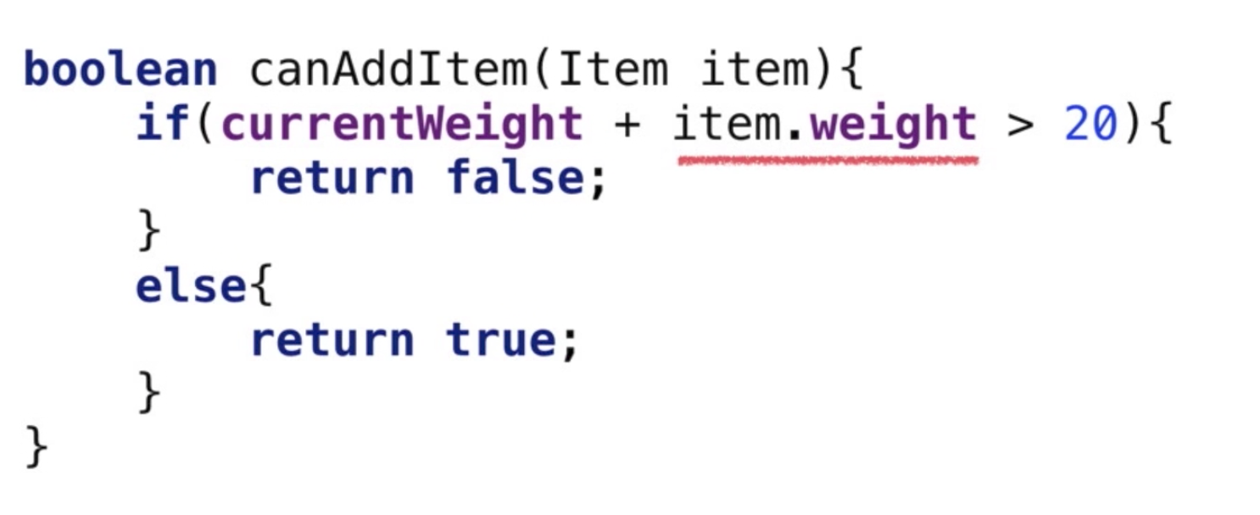

Slide 8
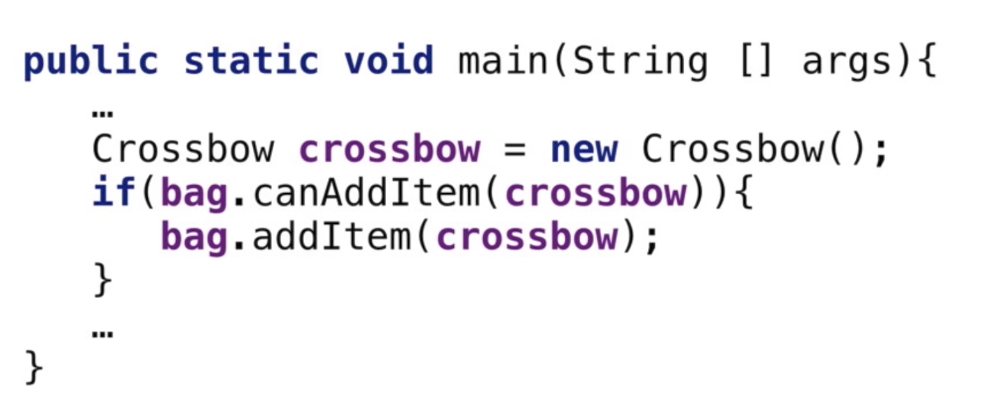
Bag & Items Example

Slide 9
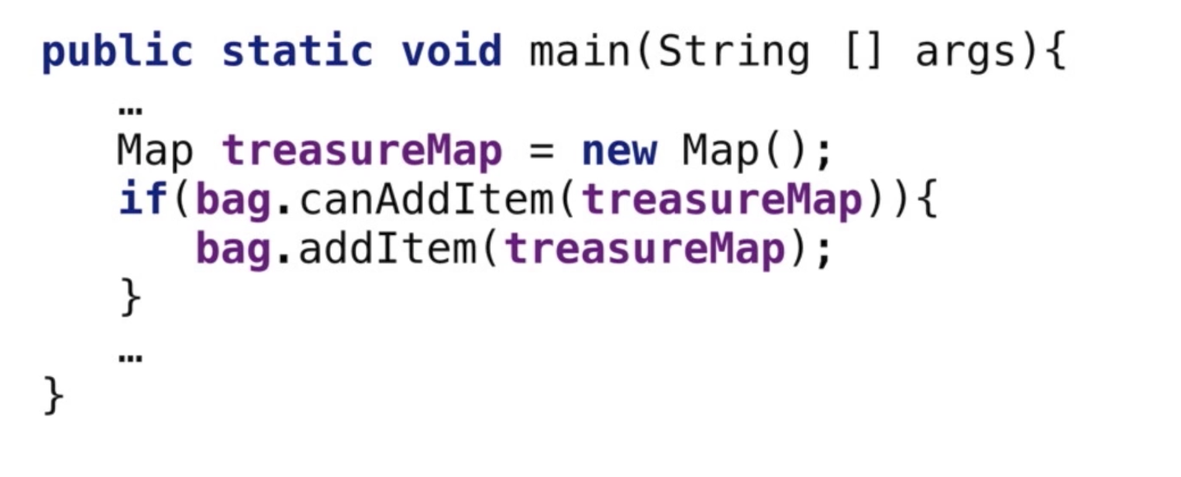
Bag & Items Example

Slide 10
Polymorhism
Superclass reference to sub class object
Person s=new Student(“Cara”, 1234);

Slide 11
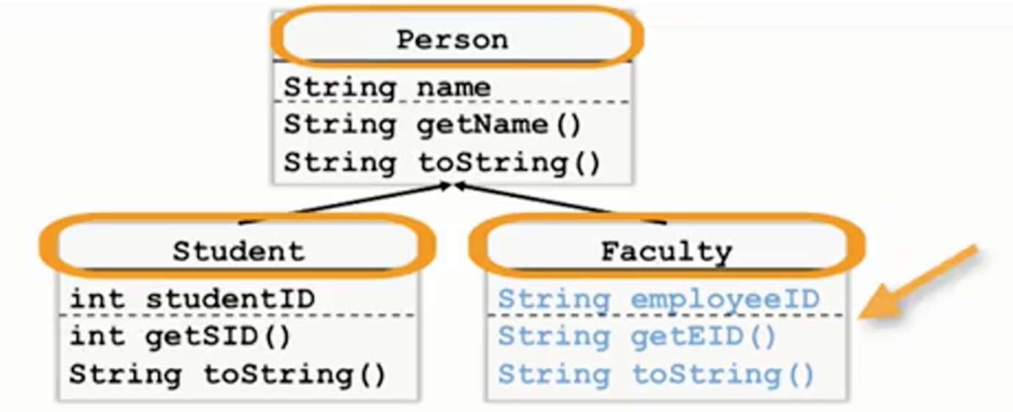

Slide 12
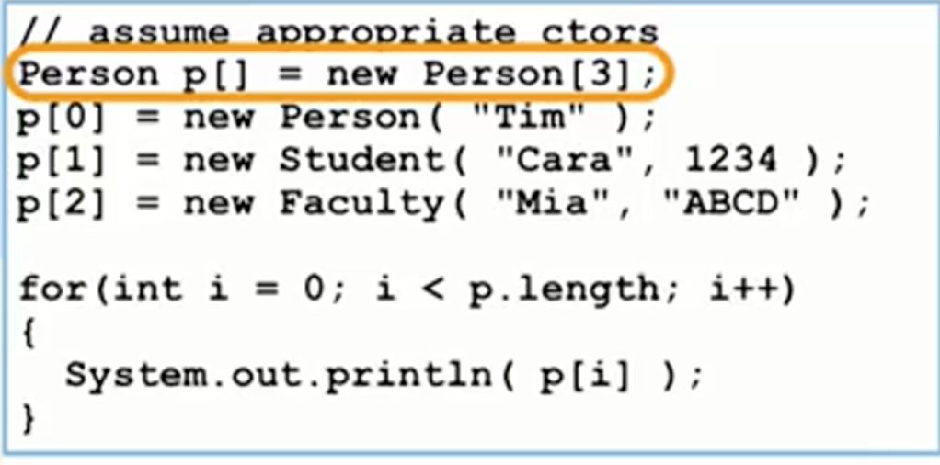

Slide 13
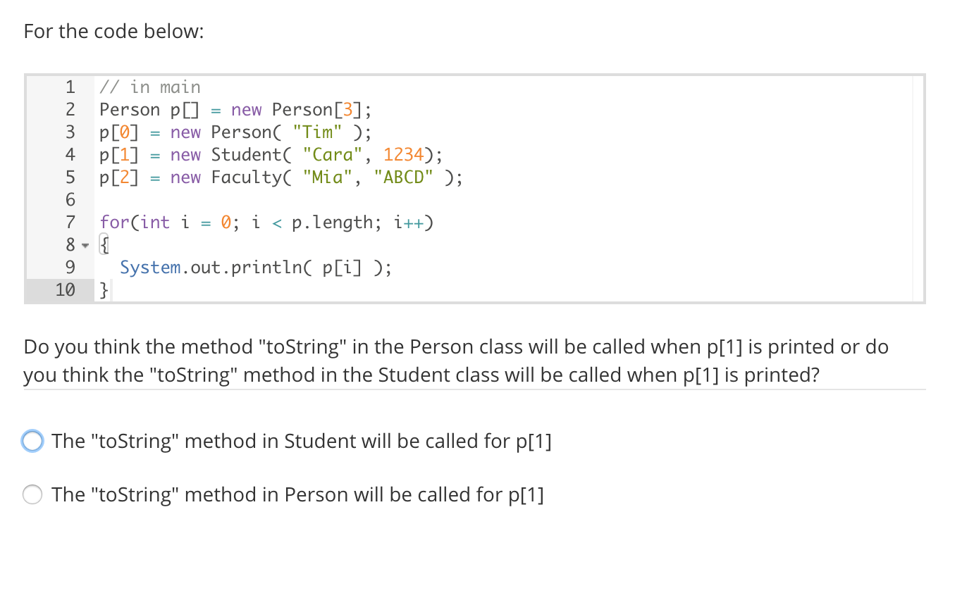
Notes:
What polymorphism gives us, is the ability to keep all of our objects in one big collection. And then call methods on every single one of our elements and the appropriate method is what actually gets called

Slide 14
Compile Time Rules
Compiler only knows reference type,
Can only look in reference type class for method
Outputs a method signature

Slide 15
Run Time Rules
Follow exact runtime type of object to find method.
Must match compile time method signature to appropriate method in actual object’s class.

Slide 16
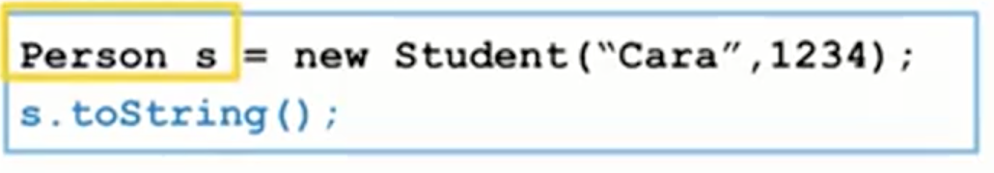
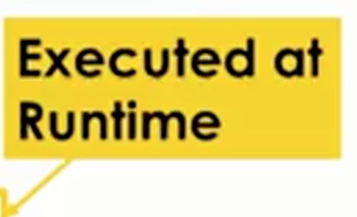

Slide 17
Casting
Step through decisions made at compile time and runtime
Use casting of objects to aid the compiler

Slide 18
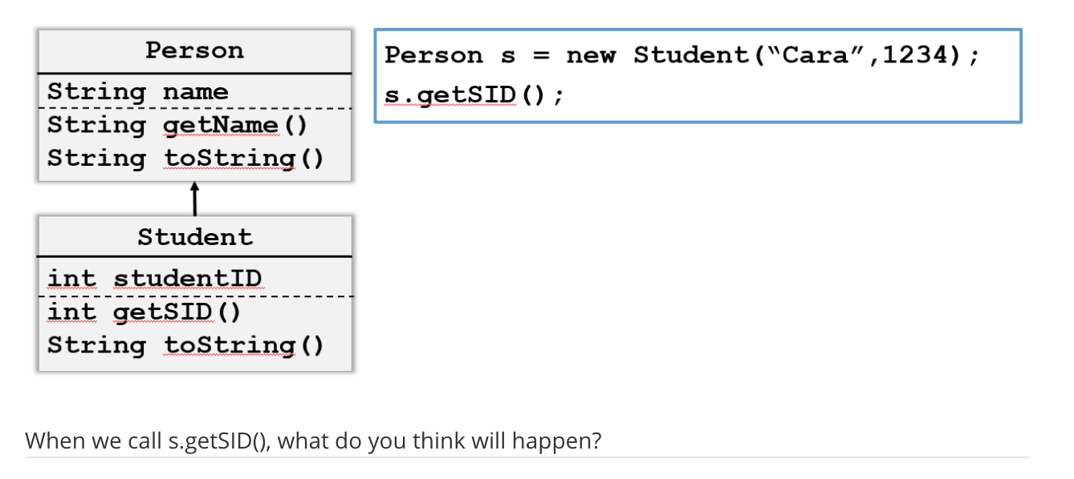

Slide 19
Casting
Automatic type promotion (like int to double)
Superclass ref=new Subclass(); (widening)
Explicit casting (like double to int)
Subclass ref=(Subclass) superRef; (narrowing)
Be careful! Compiler trusts you
Notes:
You have to be careful when you narrow

Slide 20
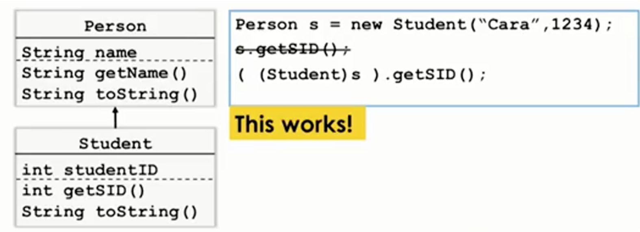

Slide 21
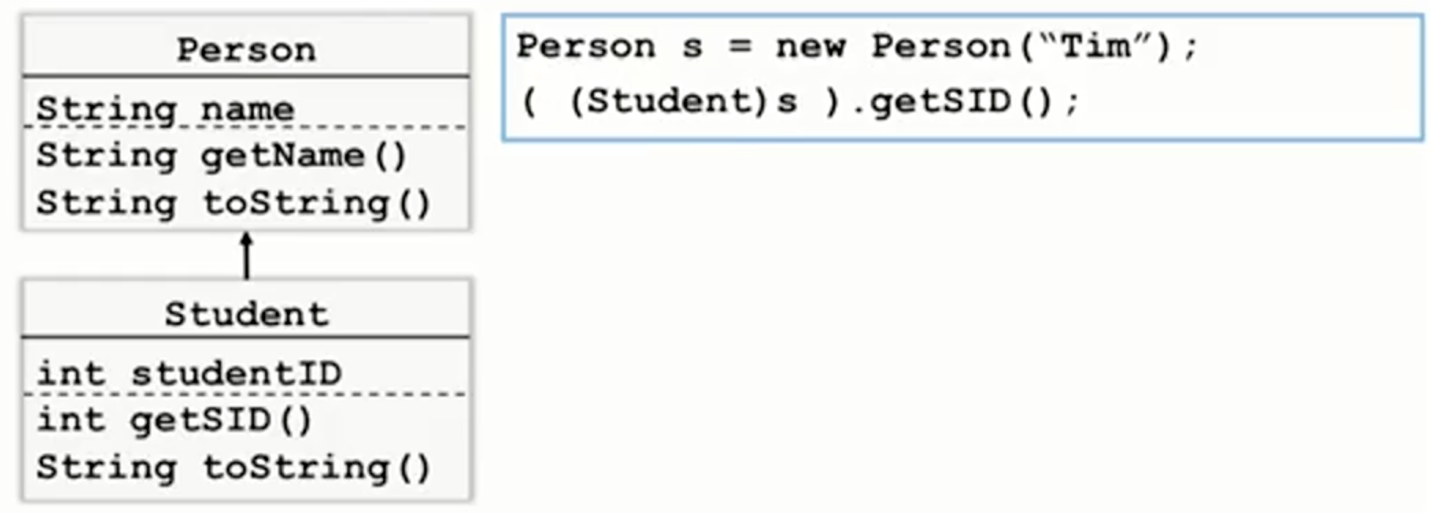

How about this?
Notes:
What would be really great is if we could just test this. Say, is this a student? Before I do the cast. And the way we can do this is using an operator instanceof

Slide 22
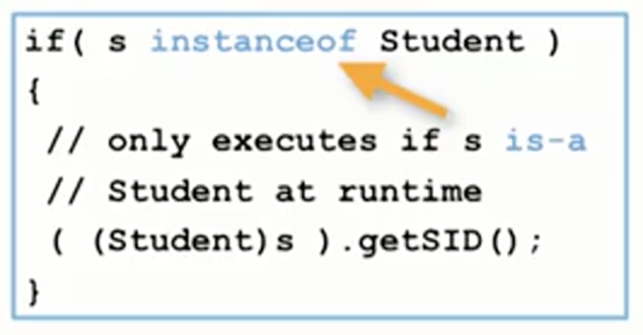
Runtime Type Check
Instanceof
Provides runtime check of is-a realtionship

Slide 23
Polymorhism
Compiler Time Decisions
Runtime Decisions

Slide 24
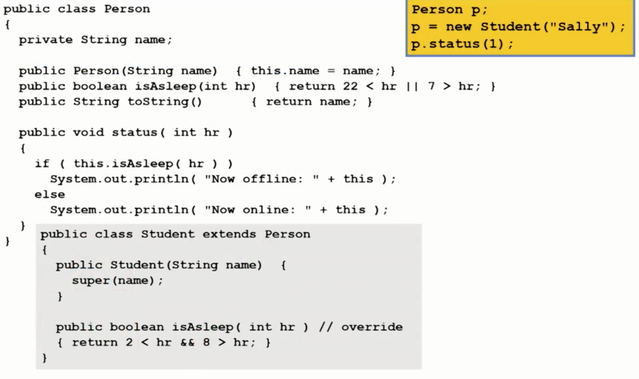
Polymorhism Challenge 1
Notes:
In this concept challenge we're gonna have some fun with polymorphism and dynamic binding

Slide 25
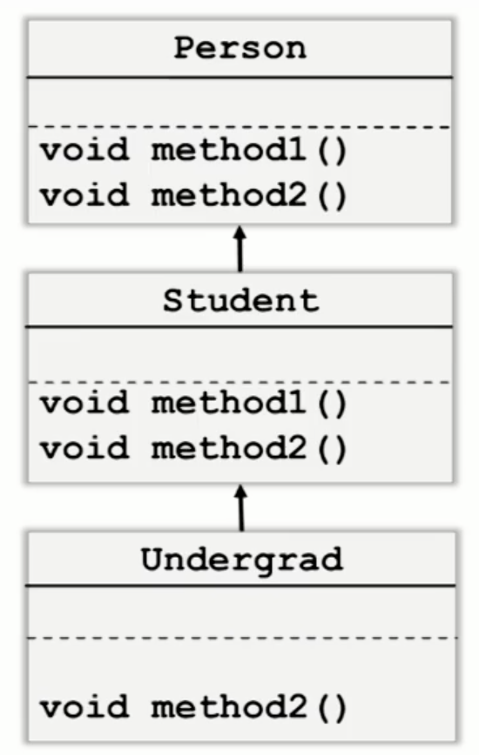
Polymorphism Challenge 2

Slide 26
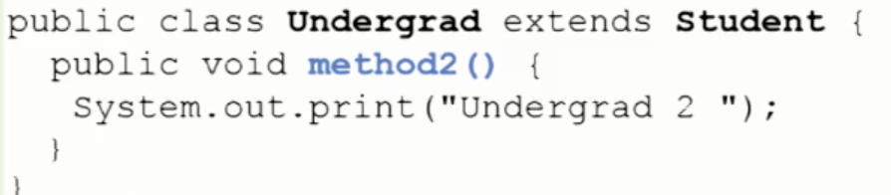
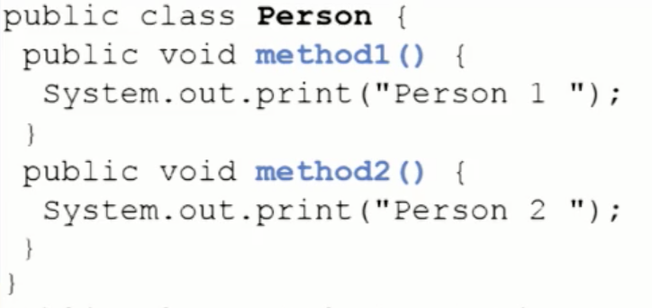
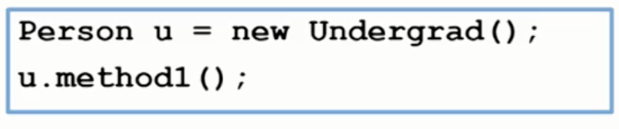
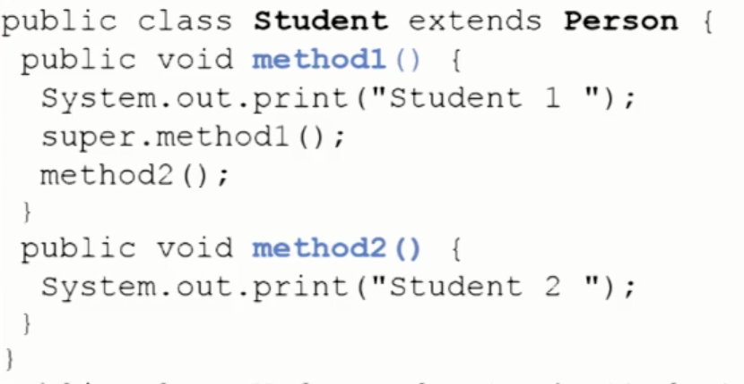
Polymorphism Challenge 2
Notes:
2nin 3. satırı static bind
Insert keyword this

Slide 27
Abstract classes and Interfaces
Use the keyword Abstract
Compare “inheritance of implementation” and “Inheritance of interface”
Decide between Abstract classes and Interfaces

Slide 28
Person- Campus Accounts
Add method “monthlyStatement”
“Person” objects no longer make sense
How do we?
Force subclasses to have this method
Stop having actual Person objects
Keep having Person references
Retain common Person code
Abstract Classes

Slide 29
Abstract
Can make any class abstract with keyword:
public abstract class Person{
Class must be abstract if any methods are:
public abstract class void monthlyStatement()
Cannot create objects of this type

Slide 30
Implementation vs. Interface
Abstract classes offer inheritance of both!
Implementation: instance variables and methods which define common behaviour
Interface: method signatures which define required behaviours. You get to inherit both implementation and interface

Slide 31
Person- Campus Accounts
Add method “monthlyStatement”
“Person” objects no longer make sense
How do we?
Force subclasses to have this method
Stop having actual Person objects
Keep having Person references
Retain common Person code
Abstract Classes
Then use an Interface!

Slide 32
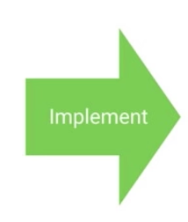
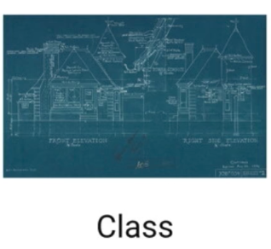

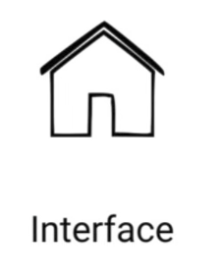

Interfaces

Slide 33
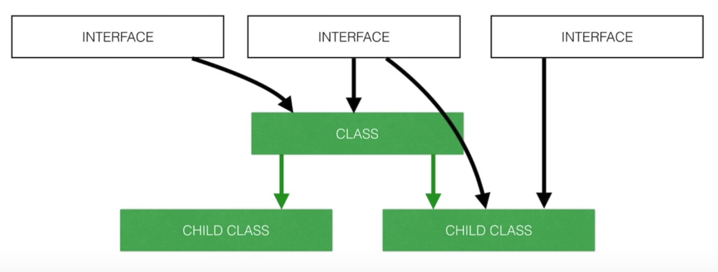
Interfaces

Slide 34
Interfaces
Interfaces only define required methods
Classes can inherit from multiple Interfaces

Slide 35
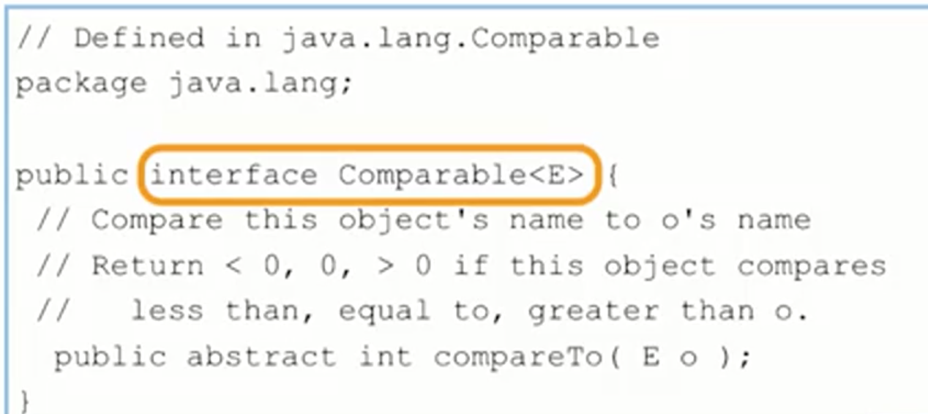

Slide 36
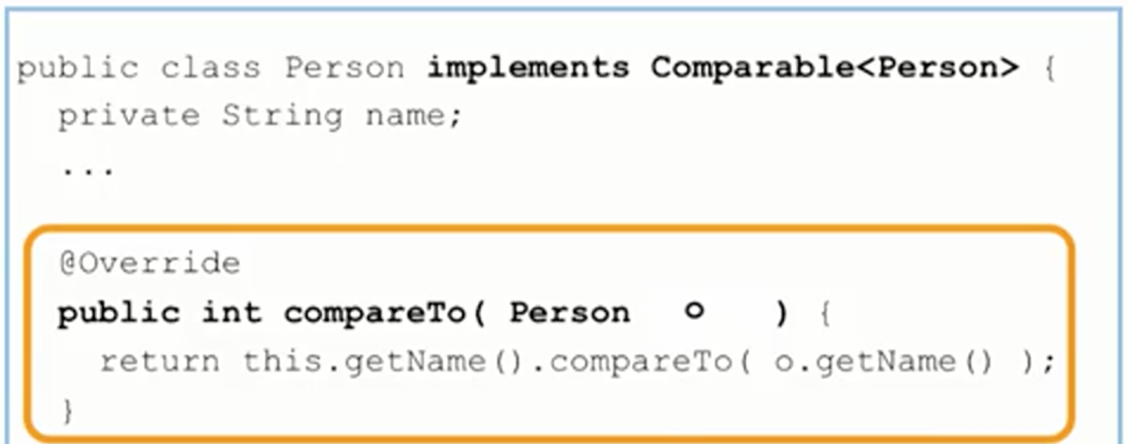

Slide 37
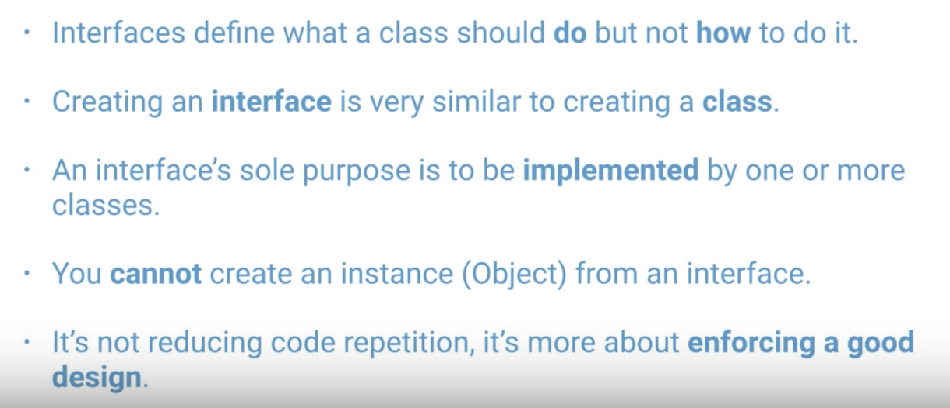
Interfaces Summary

Slide 38
Abstract class or Interface
If you just want to define a required method:
Interface
If you want to define potentially required methods AND common behaviour:
Abstract Classes

Slide 39
Polymorphism Examples

Slide 40
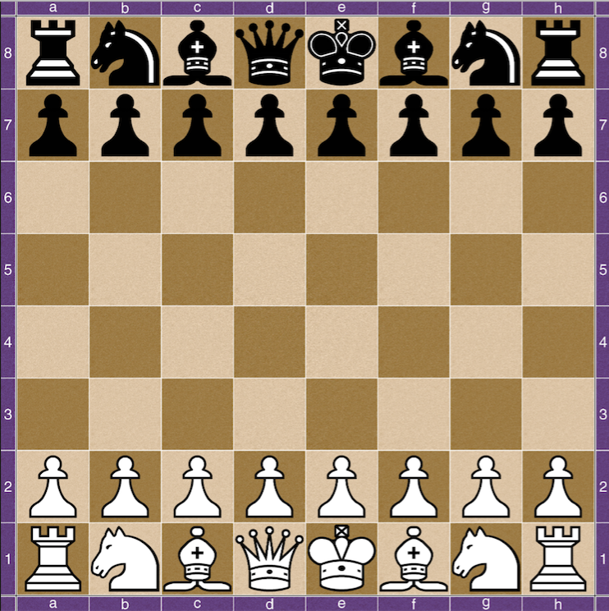
P
The Chess Example
We've seen how Inheritance allows you to extend classes and add more functionality to them.
Sometimes you not only want to extend the functionality of a class, but also modify it slightly in the child class.
For example, say you're building a Java chess game.

Slide 41
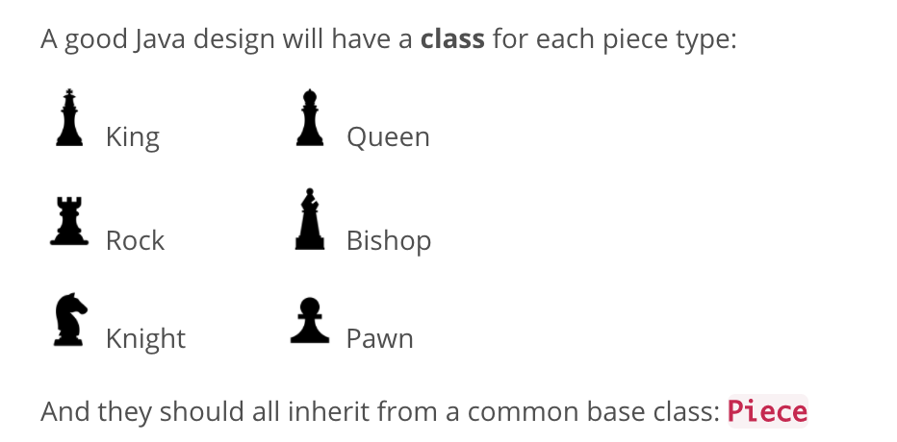

Slide 42
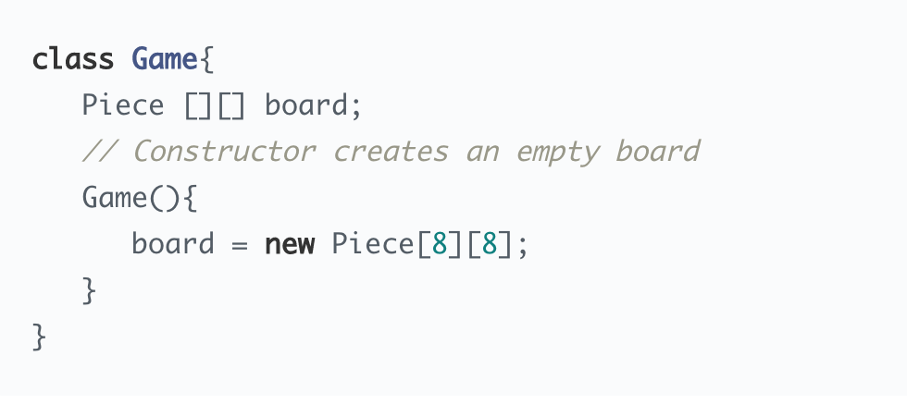

Slide 43
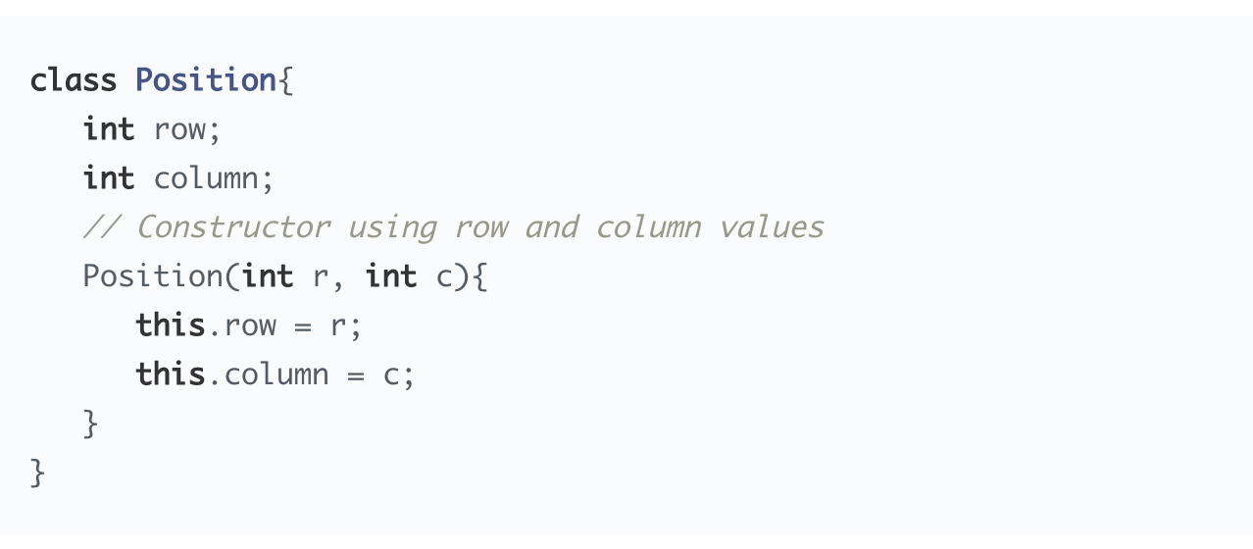
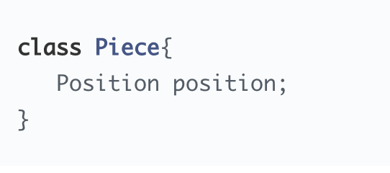

Slide 44
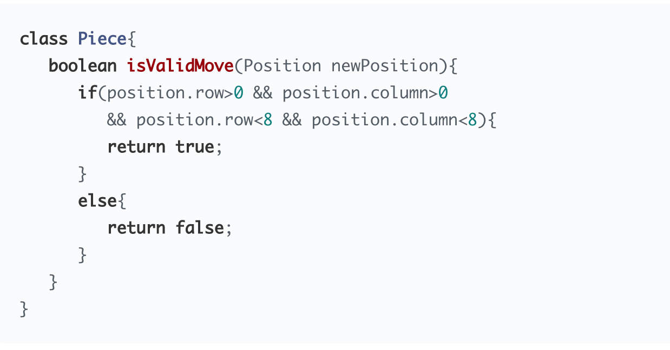

Slide 45
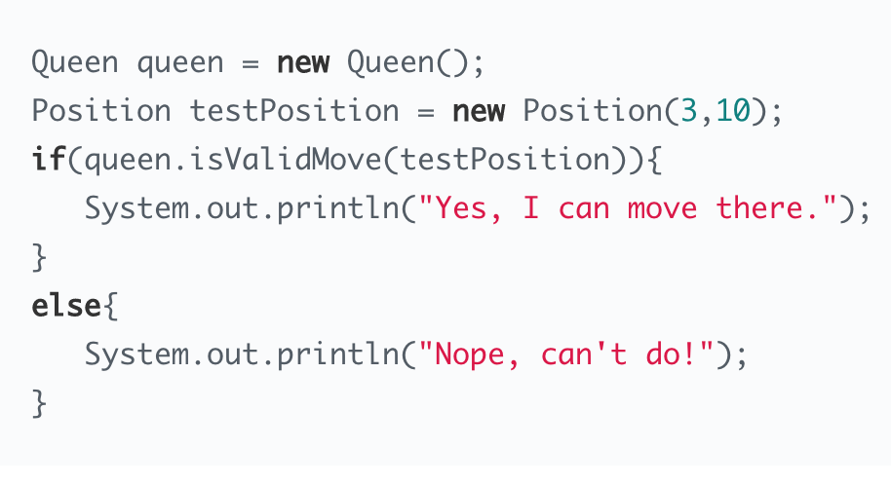

Slide 46
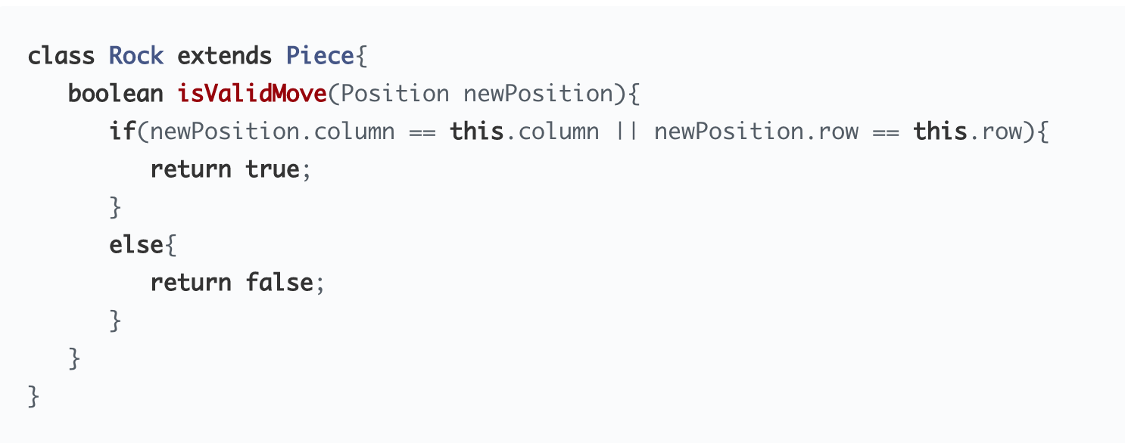

Slide 47
